Slide 1
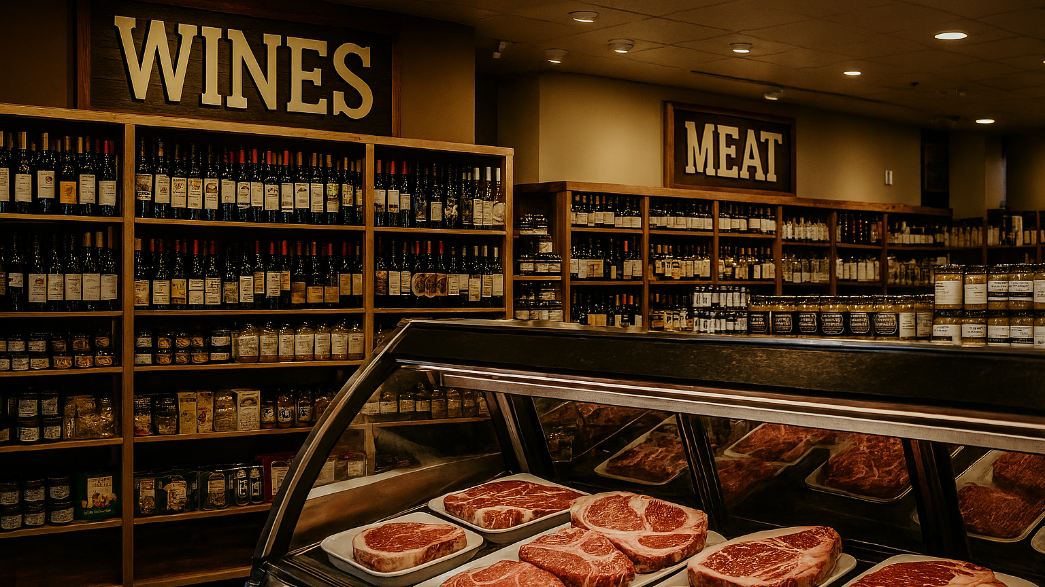
GOURMET HEAVEN
A Data-Driven Roadmap to Enhanced Customer Engagement

Slide 2









Today's Agenda
A brief overview of our data-driven journey.
1. The Customer
2. The Insights
3. The Model
4. The Strategy
5. The Impact
Understanding who we're talking to.
What the data tells us about their behavior.
How we predict future campaign success.
From insights to actionable recommendations.
The financial case for our strategy.

Slide 3
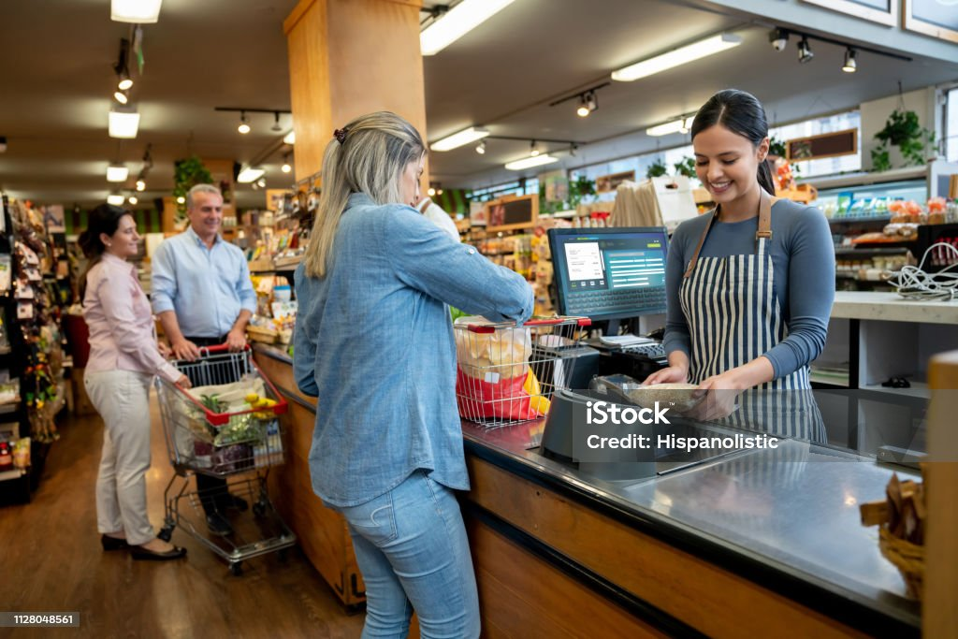






Our Customer Landscape at a Glance
Demographics
Financials
Behavior
A diverse mix of couples, singles, and other household types. Ages span from 18 to over 65, indicating a broad market appeal.
Income segments range from low to high, with varied education levels. Spending power is not uniform across our customer base.
Purchasing habits are store-dominant, but web and catalog channels show distinct behaviors. Campaign acceptance varies widely.

Slide 4
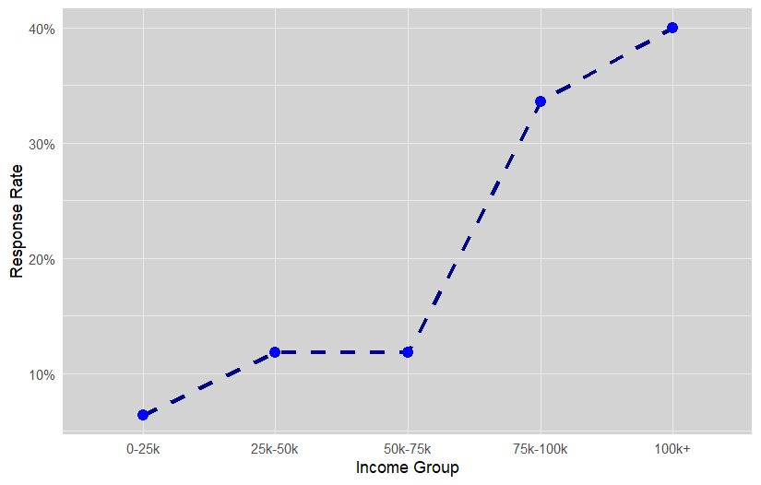

Insight 1: Income Drives Engagement
High-Income = High-Value
Customers with incomes over $75,000 are our most valuable and responsive segment. They are the clear primary target for high-value campaigns.
2-3x Higher Response Rate: The 75k-100k segment has a 33.6% response rate, compared to 11.8% for mid-tier earners.
Highest Average Spend: This group also boasts the highest average spend at $1,448.
Untapped Potential: The 100k+ segment shows a 40% response rate, indicating a highly engaged (though small) group.

Slide 5
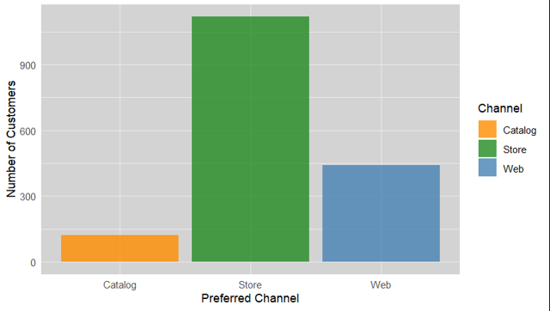
Insight 2: Channel Defines Behavior
Store is Core, Catalog is Gold
While most customers shop in-store, our catalog shoppers are a hidden gem of profitability and engagement.
Store (66.5%): The vast majority of customers. They have the lowest response rate (9.9%) and moderate spend ($551). This is an efficiency challenge.
Catalog (7.3%): Our smallest segment, but our most valuable. They have the highest response rate (36.9%) and highest average spend ($1,289).
Web (26.2%): A strong, growing segment with a solid 21.5% response rate. A key area for digital nurture.

Slide 6
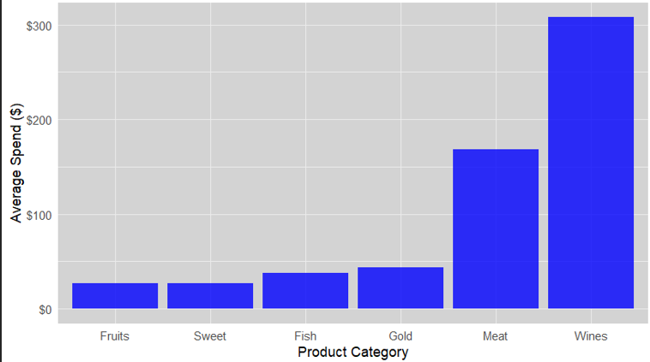
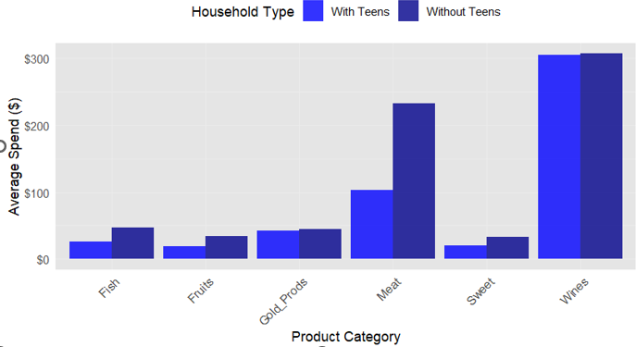
Insight 3: Product & Household Spending

Slide 7


Key Takeaways: Product & Household
Wines and Meat Dominate
The "Teen" Spending Gap
Across all age groups and channels, Wines and Meat are the two highest-spend categories. They are the core drivers of our revenue and should be the focus of in-store promotions and campaign offers.
Households with teens spend significantly less on Meat than households without teens (Avg. $105 vs. $230). This isn't a problem—it's a clear opportunity for targeted bundling. We should create separate offers (e.g., "Family Night Bundle" vs. "Gourmet Selections") for these distinct segments.

Slide 8


Building the Predictive Model
From Data to Data-Driven Decisions

Slide 9
The Model: Our Approach
Why XGBoost?
We tested multiple models and selected XGBoost for its superior performance. An 89% AUC score means our model is highly effective at distinguishing between a customer who will accept an offer and one who will not.
89%
Observations: 1,792
Final Model Accuracy (AUC)
Base Predictors: 26
Engineered Features: 11
Training / Testing Split: 80% / 20%

Slide 10
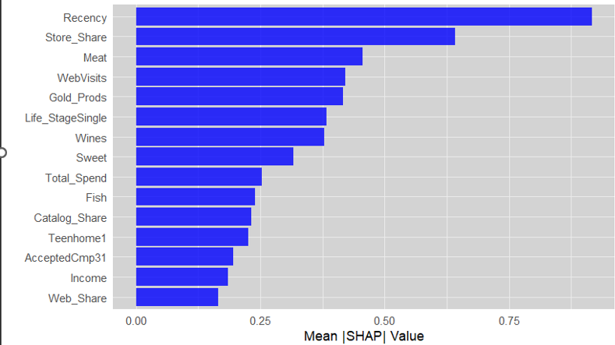
What Drives a "Yes"? (SHAP Feature Importance)
Behavior > Demographics
The model's "brain" (SHAP analysis) reveals that *what customers do* is more predictive than *who they are*.
Recency: When was their last visit? This is the #1 predictor.
Store_Share: What percentage of their purchases are in-store?
Meat: Do they buy from our meat department?
WebVisits: How often do they browse our site?
Gold_Prods: Do they buy specialty/gold products?

Slide 11
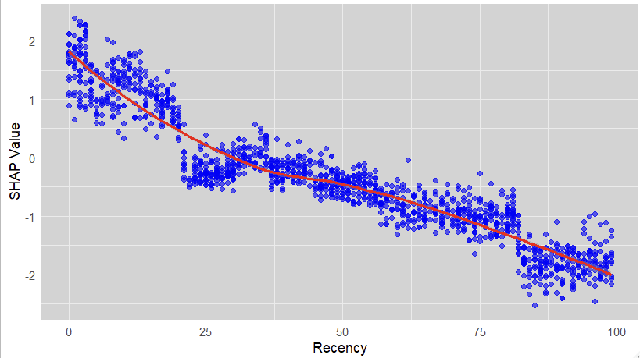
Deep Dive: The 25-Day "Golden Window"
Targeting Recency
The model's #1 predictor, Recency, gives us a clear window for action. A customer's likelihood to accept an offer drops dramatically after 25 days.
The SHAP plot shows a high positive impact (value > 0) for customers with a Recency of 0-25 days.
After 25 days, the impact becomes strongly negative (value < 0).
Strategy: We must deploy campaigns to target customers *before* this 25-day window closes. For customers outside it, a different "reactivation" strategy is needed.

Slide 12

Strategic Recommendations
From Insights to Actionable, Data-Driven Strategy

Slide 13







Our 4-Point Action Plan
1. Target High-Value Segments
2. Personalize Product Bundles
3. Build a Reactivation Strategy
4. Optimize Channel Focus
Prioritize all campaigns for customers with income >$75k and high recency (0-25 days).
Stop one-size-fits-all. Create "Wine & Meat" bundles and separate offers for households *with teens*.
For customers with Recency > 25 days, deploy a specific "Welcome Back" campaign to re-engage them.
Nurture high-profit Catalog & Web users. Focus in-store promotions on key drivers: Wine & Meat.

Slide 14

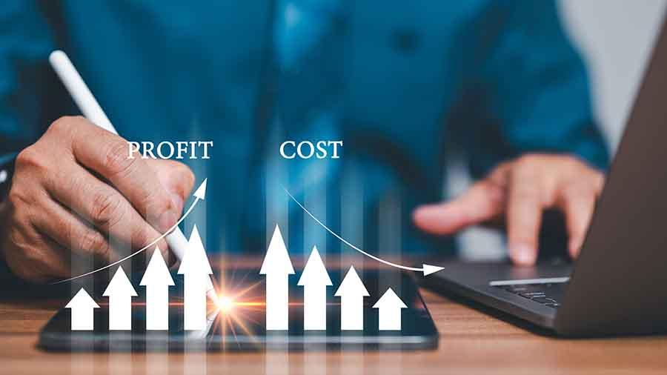
The Financial Impact
A Cost-Benefit Analysis for Implementation

Slide 15
Implementation Costs (Year 1)
Initiative | Category | Software | Services | Internal | License | Y1 Total | Priority
Customer Segmentation Platform | Core Platform | $15,000 | $10,000 | $8,000 | $9,000 | $42,000 | 1
Personalized Campaign System | Campaign Mgt | $12,000 | $8,000 | $6,000 | $7,200 | $33,200 | 2
Multi-Channel Optimization | Channel Mgt | $8,000 | $5,000 | $4,000 | $4,800 | $21,800 | 3
A/B Testing Infrastructure | Optimization | $6,000 | $4,000 | $3,000 | $3,600 | $16,600 | 4
Advanced Analytics & Reporting | Analytics | $8,000 | $6,000 | $5,000 | $6,000 | $25,000 | 5
Staff Training & Change Mgt | People | $10,000 | $6,000 | $12,000 | $0 | $28,000 | 6

Slide 16
Benefit Projection (Annual Value)
Benefit Source | Primary Initiative | Mod. Lift | Compounding | Annual Value
Improved Targeting Efficiency | Customer Segmentation Platform | 15.0% | 8.0% | $20,653.42
Personalization Lift | Personalized Campaign System | 12.0% | 6.0% | $16,522.74
Channel Optimization | Multi-Channel Optimization | 9.0% | 5.0% | $12,392.05
Increased Customer Lifetime Value | Advanced Analytics & Reporting | 10.0% | 7.0% | $13,768.95
Testing & Optimization | A/B Testing Infrastructure | 6.0% | 4.0% | $8,261.37
Reduced Acquisition Cost | Staff Training & Change Mgt | -2.0% | 3.0% | -$2,753.79

Slide 17
Annual Financial Projection (Top 3 Initiatives)
Period | Implementation Cost | License Cost | Internal Cost | Total Cost | Benefits | Net Cash Flow
Implementation | $76,000.00 | $0.00 | $6,000.00 | $82,000.00 | $0.00 | -$82,000.00
Year 1 | $0.00 | $21,000.00 | $4,725.00 | $25,725.00 | $29,740.93 | $4,015.93
Year 2 | $0.00 | $22,050.00 | $4,961.25 | $27,011.25 | $46,569.33 | $19,558.08
Year 3 | $0.00 | $23,152.50 | $5,209.31 | $28,361.81 | $52,634.03 | $24,272.21

Slide 18
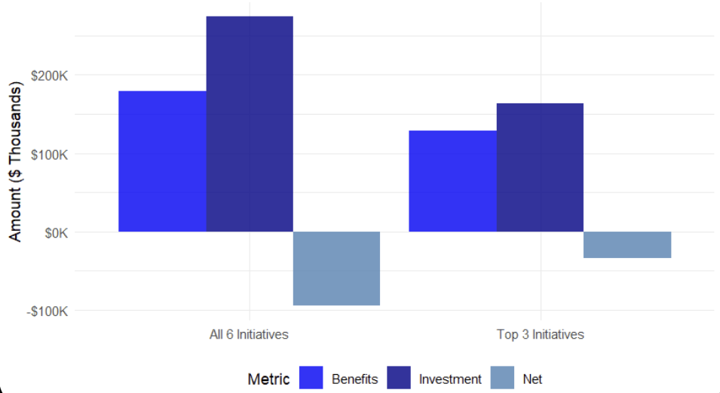
3-Year Investment vs. Benefits Comparison
The "Top 3 First" strategy is the clear winner. It minimizes initial financial risk and allows the project to become self-funding faster

Slide 19
Risk & Mitigation Strategy
Risk Factor | Probability | Impact | Mitigation Strategy | Top 3 Advantage
Implementation Delays | Medium | High | Phased implementation with clear milestones | Easier coordination
Benefit Realization Lag | Low | High | Conservative benefit ramp-up assumptions | Faster learning
Staff Adoption Resistance | Medium | Medium | Comprehensive training & change management | Focused training
Technology Integration Issues | Low | High | Technical proof-of-concept before full rollout | Simpler integration
Data Quality Problems | Medium | Medium | Data audit and cleanup during implementation | Targeted cleanup

Slide 20




Final Recommendation & Justification
Recommendation
Justification & Metrics
Implement Top 3 Initiatives First
A phased approach provides a clear path to profitability, with compounding benefits growing year-over-year.
Focus on Segmentation, Personalization, and Channel Optimization to achieve the fastest path to positive returns.
Primary Justification: Superior financial returns
Key Metrics (ROI): -20.9% (Initial), Payback > 3 yrs
Compounding Advantage: 6.6% Y-o-Y growth
Year 1 Investment: $97,000

Slide 21
Thank You
Questions & Discussion

Slide 22
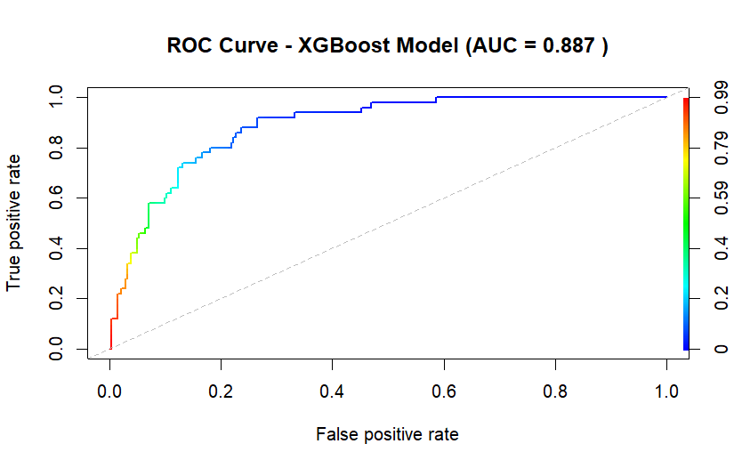
Appendix A: Model Performance
Model | AUC Score | Selected
XGBoost | 0.89 (0.887) | Yes
Random Forest | 0.84 | No

Slide 23
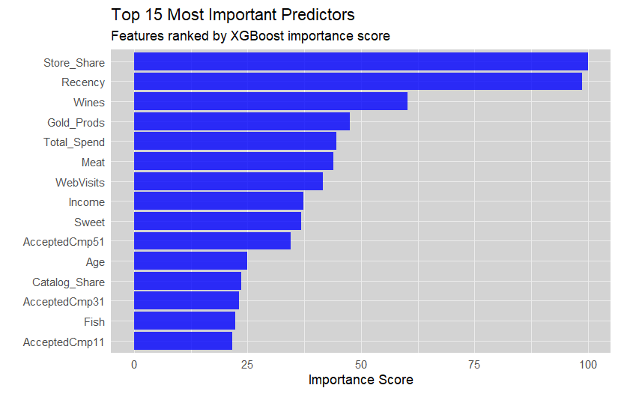
Appendix B: Full Feature Importance (XGBoost)

Slide 24



Sources
https://img.freepik.com/premium-photo/abstract-financial-chart-with-dynamic-lines-geometric-shapes-dark-blue-background-concept-data-analysis-3d-rendering_670147-105905.jpg
Source: www.freepik.com
https://media.istockphoto.com/id/1355901933/vector/concentric-circles-abstract-background.jpg?s=612x612&w=0&k=20&c=wgTl1zCpneLx0Jll5W98SDIfNodesMsV20ke_o8CR2w=
Source: www.istockphoto.com
https://experienceleague.adobe.com/en/docs/blueprints-learn/architecture/customer-journeys/campaign-v8/campaign-v8-overview

